Slide 1
UGBA 141 Production and Operations Management
Queue II Performance Metrics
Professor Park Sinchaisri
Notes:
Agenda
Capability Analysis + Six Sigma
Ritz-Carlton Case
Service Excellence

Slide 2
Course Announcements
Agenda: Performance metrics of a queueing system
Waiting Time + Throughput Losses
Today: Pick a name for your team!
Friday: HW4 due, review Queueing concepts
Next Week: Littlefield Simulation
Starts Monday 1 pm, ends Thursday 4pm
No classes on Mon/Wed, make-up on Friday
You have access to platform! Look at historical data!
Notes:
https://hbsp.harvard.edu/product/4386-HTM-ENG
https://hbsp.harvard.edu/product/4386-HTM-ENG?activeTab=try-now&itemFindingMethod=

Slide 3
Recap Multi-Server Queue
Arriving customers
Departing customers
Customers waiting for service
Multiple
servers
Assumptions:
All servers are equally skilled, i.e., they all take p time to process each customer.
Each customer is served by only one server.
Customers wait in one line until their service is completed.
There is sufficient capacity to serve all demand.
a = average interarrival time
Demand = 1 / a = λ
p = average processing time
Capacity of each server = 1 / p = μ
m = number of servers
Capacity = m / p
CV = SD / average
Notes:
So for a general case with any number of servers, but still one queue.
Assumptions:
All servers are equally skilled, i.e., they all take p time to process each customer.
Each customer is served by only one server.
Customers wait until their service is completed.
There is sufficient capacity to serve all demand.

Slide 4
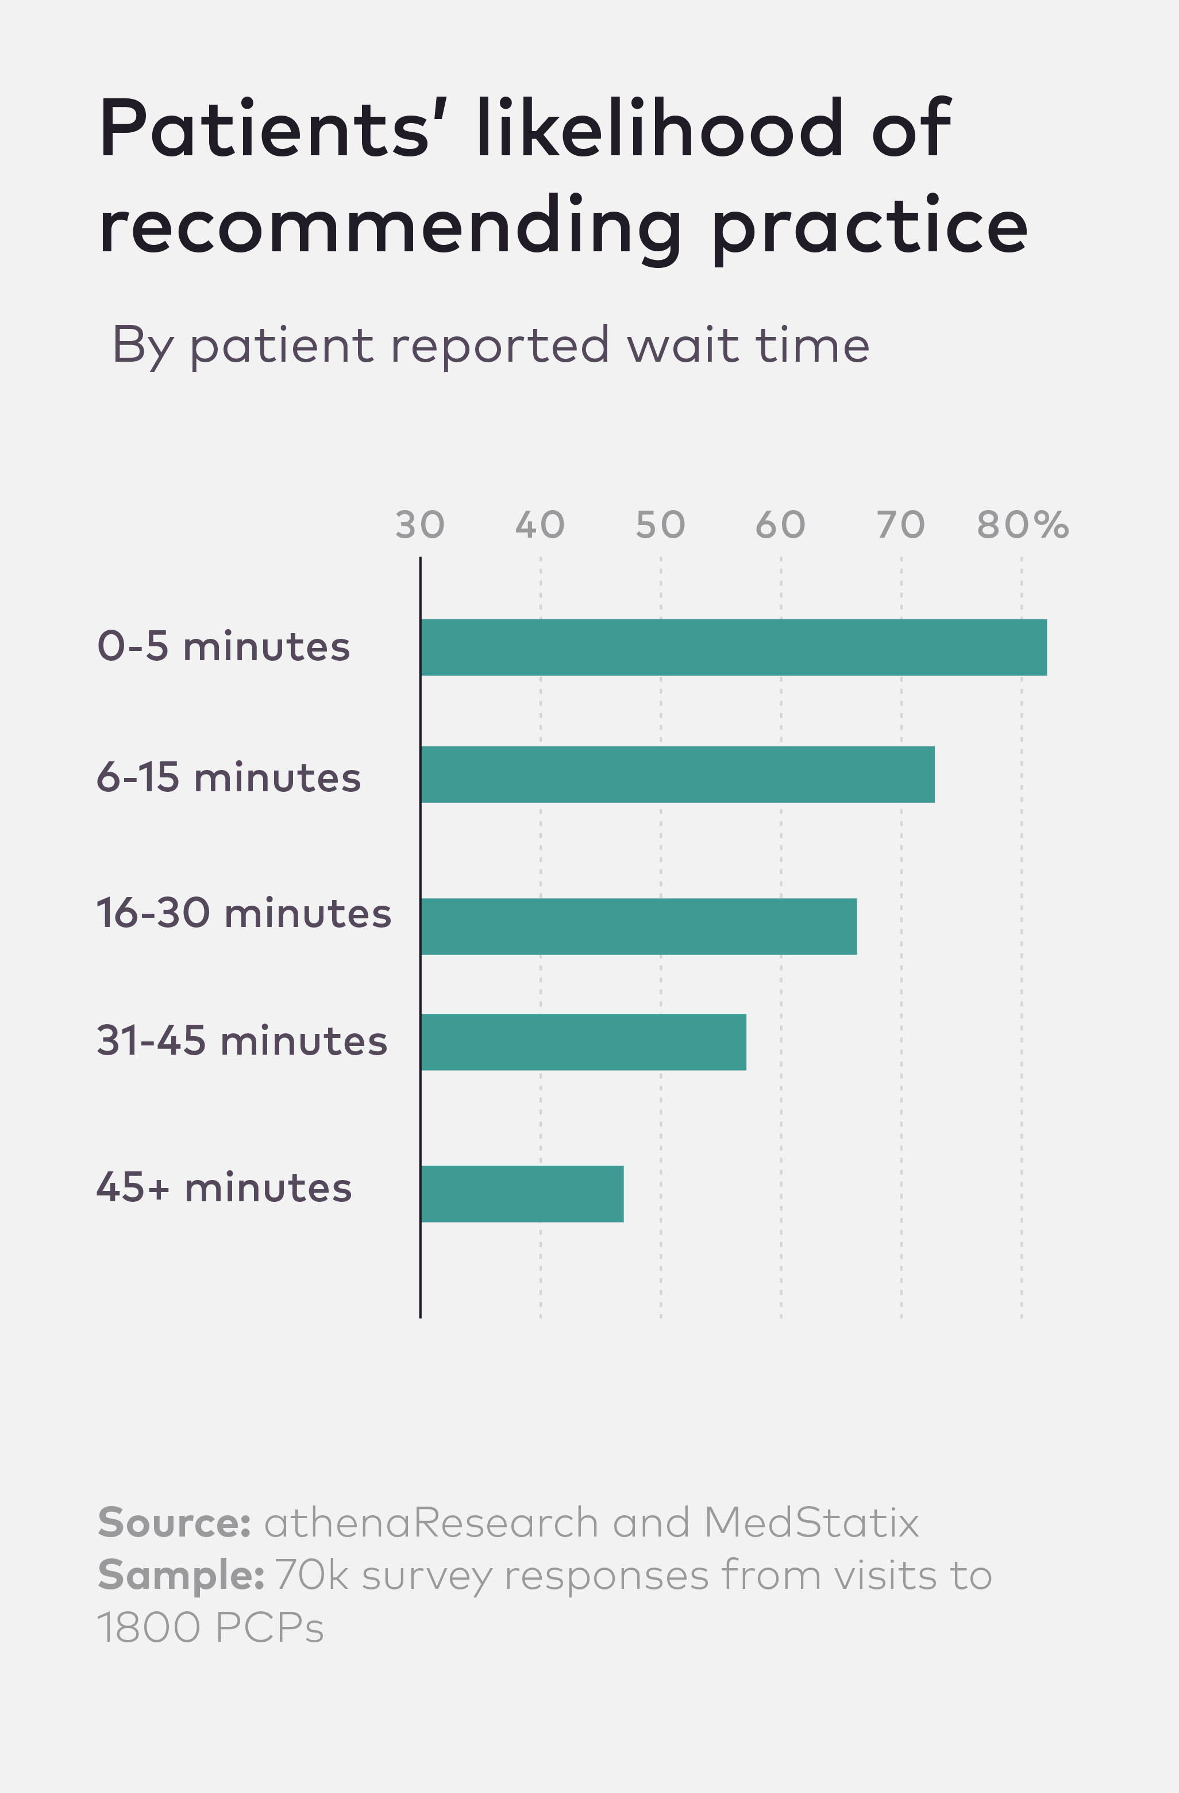
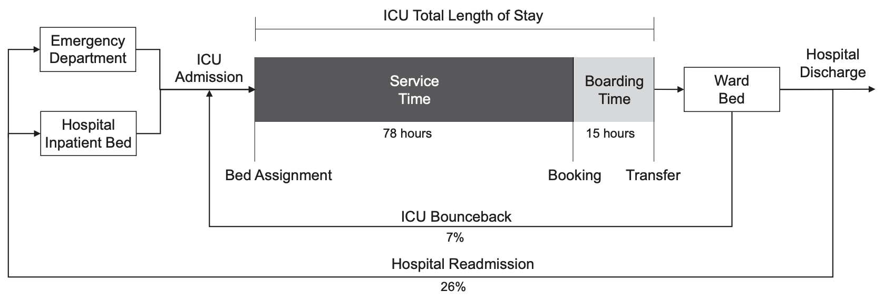
Waiting in Healthcare
More than one quarter of 36 M hospital admissions involve a stay in an intensive care unit (ICU) annually, accounting for $130 B.
Patients spent on average ~4 days in the ICU, 15 hours longer than necessary.
Median ER wait time = 336 minutes
1 additional hour of waiting increases P(dying) by 4.1 percentage point
Source: Long & Mathews “The Boarding Patient: Effects of ICU and Hospital Occupancy Surges on Patient Flow” (2018), Centers for Medicare & Medicaid Services
Notes:
One observational study finds that timely ICU admission reduces 28-day mortality by 30% (Edbrooke et al. 2011).

Slide 5
Time in Queue/Waiting Time
Recall: p = processing time, m = number of servers Utilization = demand / capacity = p / ma
For any number of servers m:
T_{q} = Time in queue
Single-server m = 1:
The above Time in queue equation works only for a stable system, i.e., a system with implied utilization less than 100%, with one line.
Notes:
Wouldn’t be nice if I could have a formula for that
Predict how much waiting is it going to be as a function of some inputs. It will have to do with the variability, Cva and CVp. Also the utilization. If utilization is high, we expect more waiting.

Slide 6
Time in Queue/Waiting Time
The capacity factor:
Average processing time of the system = p.
Demand does not influence this factor.
The variability factor:
This is how variability influences time in queue. The more variability (holding average demand and capacity constant) the more time in queue.
The utilization factor:
Average demand influences this factor because utilization is the ratio of demand to capacity.
Notes:
For any queue, the expected time in the queue as function of 3 things.
First is average processing time. For Dr. Toyota it was 4 minutes.
Let me skip over the second ratio for the moment
The third ratio measures variability in the process.
In Dr. Toyota’s case, when no variations -> this whole thing become zero.
But if we have now random arrival and processing times.
Second ratio: Utilization / (1- utilization)
From calculus, x/1-x if X is close to 1 it gets ugly right.
0.8/1-0.8 = 4, 0.9/1-0.9 = 9.
Now we realize an innocent 10% more work is enough to double the waiting time.
Systems have to be responsive and acting very allergic to more work in a world of variability.
In the Dr. Toyota’s case if you have no variability, you can run the system at 99% utilization and you’re fine. But the moment you have variability, you will have to be happy to have a utilization that is strictly less than 1. the more you load onto the sysem, the more the waiting times are going to explode and that’s arguably a bad thing.
Does this make sense?
The above Time in queue equation works only for a stable system, i.e., a system with implied utilization less than 100%

Slide 7
Time Spent in the System
For any number of servers m:
T_{q} = Time in queue
p = Time in service
T = T_{q} + p = Flow time
Single-server m = 1:
Time in system (T) = Time in queue (T_{q}) + Time in service (p)
Notes:
Wouldn’t be nice if I could have a formula for that
Predict how much waiting is it going to be as a function of some inputs. It will have to do with the variability, Cva and CVp. Also the utilization. If utilization is high, we expect more waiting.

Slide 8

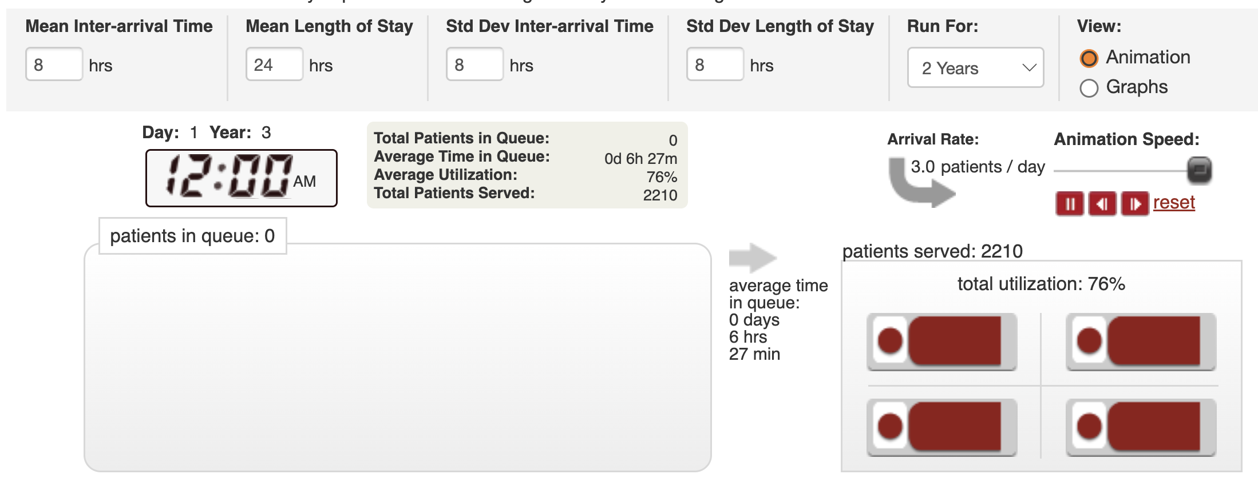
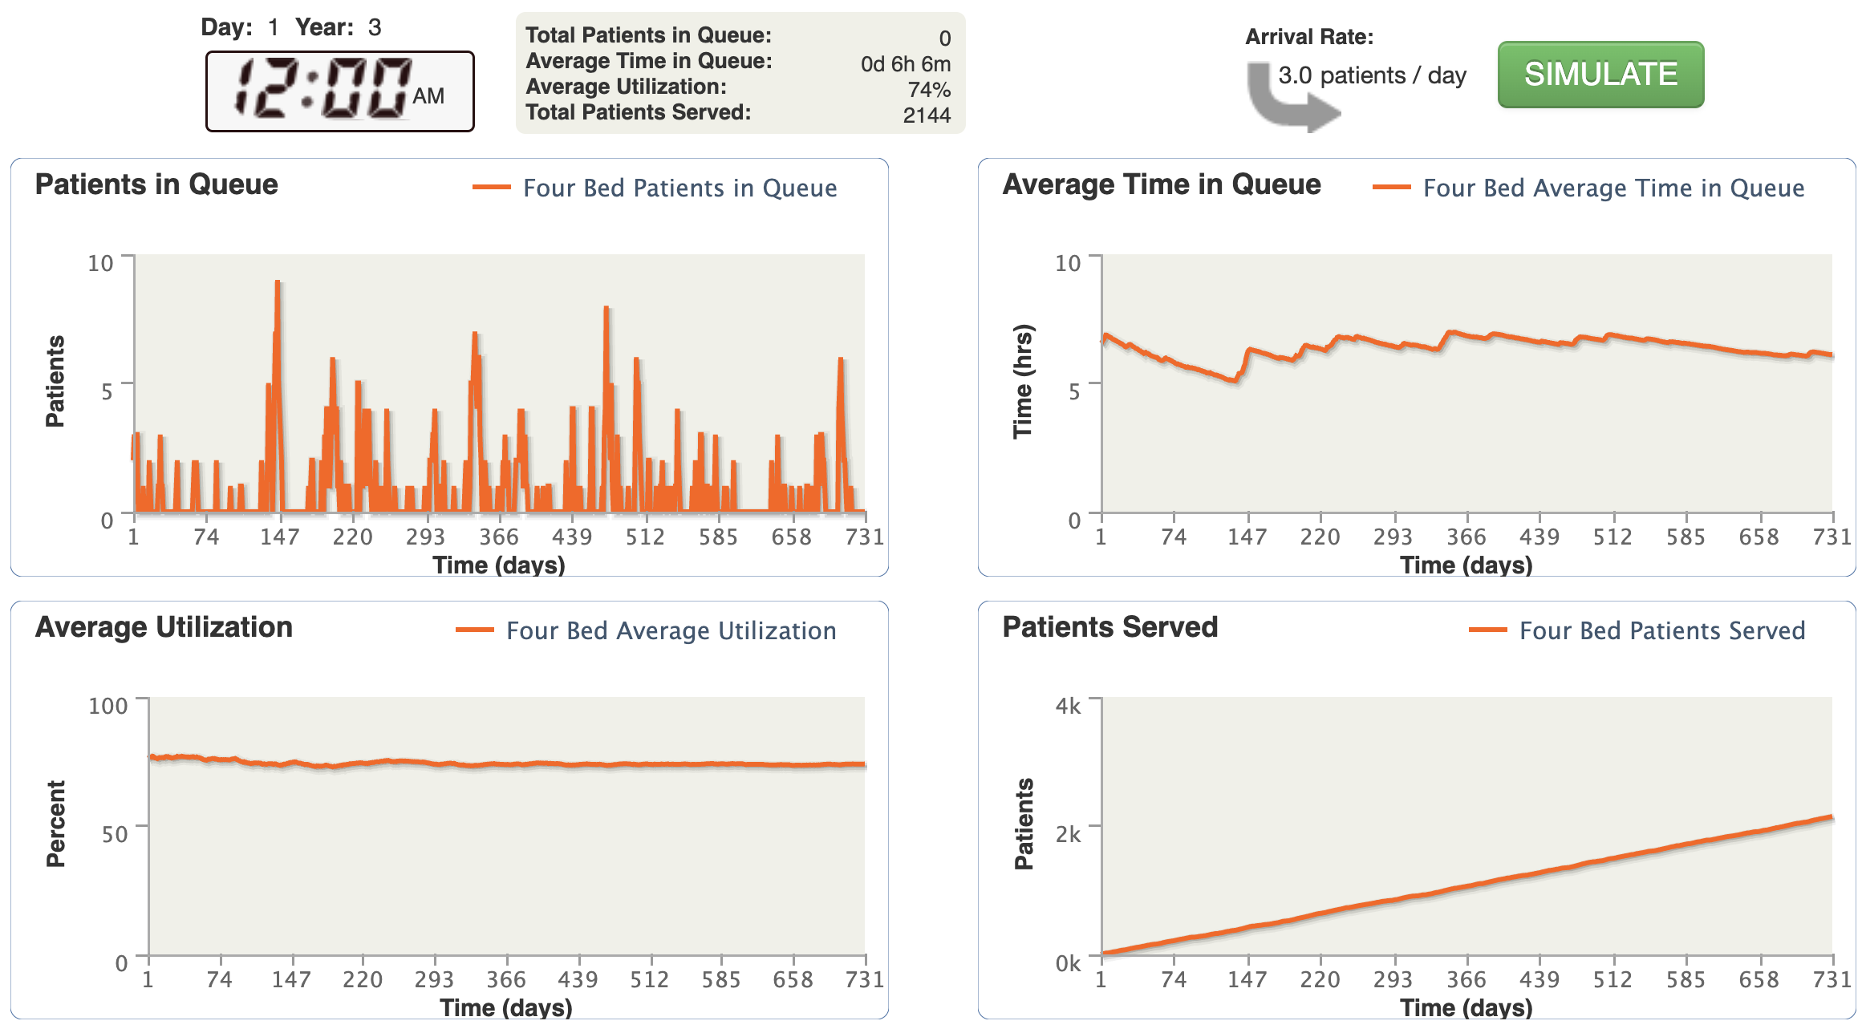
Practice 4-Bed ICU
Alta Bates’ ICU has 4 beds and runs 24 hours a day.
On average, 3 patients are admitted to ICU each day.
On average, a patient spends 24 hours in the ICU.
SD of interarrival time = 12 hours, SD of length of stay = 12 hours.
a = 8 hours, CV_{a} = 1.5
p = 24 hours, CV_{p} = 0.5
U = 24 / (8 x 4) = 0.75
Time in queue = 16.11 hours
Flow time = 16.11 + 24 = 40.11 hours
T_{q} = Time in queue
Time in system
Notes:
a = 8 hours, CVa = 1.5
p = 24 hours, CVp = 0.5
U = 24 / (8 x 4) = 0.75
Time in queue = 16.11 hours
Flow time = 16.11 + 24 = 40.11 hours

Slide 9
# Customers in the System
Use Little’s Law, I = R x T
R = Flow Rate = (1/a )
The flow rate equals the demand rate because we are demand constrained (implied utilization is less than 100%)
I_{q} = (1/a ) x T_{q} = T_{q} / a
I_{p} = (1/a ) x p = p / a
Note, the number of servers, m , does not influence the number in service, I_{p}, because as long as the the system is stable, m > p / a, the flow rate is a constant 1/a for any value for m.
I_{q} = Inventory in queue
I_{p} = Inventory in service
Inventory in the system
I = I_{q} + I_{p}

Slide 10
Practice 4-Bed ICU
a = 8 hours, p = 24 hours, m = 4
Time in queue: 16.11 hours, in service: 24 hours, in system: 40.11 hours
How many patients are waiting in the queue on average?
I_{q} = R_{q} x T_{q} = (1/a) x (T_{q}) = 16.11 / 8 = 2.01 patients waiting
How many patients are in the system on average?
I_{p} = R_{p} x T_{p} = (1/a) x p = 24 / 8 = 3 patients being served
I = I_{q} + I_{p} = 2.01 + 3 = 5.01 patients

Slide 11
Special Case Poisson/Exponential
If we have a single server (m = 1) + interarrival time a and processing time p are exponentially distributed (CV_{a} and CV_{p} = 1),
λ = mean arrival rate (mean interarrival time = 1/ λ)
μ = mean service rate (mean processing time= 1/μ)
ρ = average utilization = λ / μ
Time in queue = ρ / (μ (1 - ρ))
Time in system = 1 / (μ (1 - ρ))
# people in queue = ρ² / (1 - ρ)
# people in system = ρ / (1 - ρ)

Slide 12
Utilization + Performance
Time in queue increases dramatically as the utilization approaches 100%.
Processing time = 120
m = 4
CV_{a} = 1
CV_{p} = 1.25

Slide 13
Economies of Scale
Processing time = 120
CV_{a} = 1, CV_{p} = 1.25
With only 4 servers, the tradeoff curve is steep
Systems with more servers (i.e., higher scale) can operate at higher utilizations with less adverse impact
Suppose utilization increases from 85% to 91%:
With only m = 4, time in queue increases 168 secs (from 180 to 348)
With m = 40, time in queue increases 13 secs (from 7 to 20)
m = 4
m = 8
m = 40

Slide 14
Economies of Scale
Processing time = 120
CV_{a} = 1, CV_{p} = 1.25
Moving from a m=4 system with about 85% utilization to a m = 40 system gives options:
A to B: keep utilization constant but decrease Tq
A to C: keep Tq constant, but increase utilization
A to D: reduce Tq and increase utilization
m = 4
m = 8
m = 40
A
C
B
D
Economies of scale allows the firm to “have its cake and eat it too”, i.e., better service (lower Tq ) and lower labor costs (higher utilization).

Slide 15

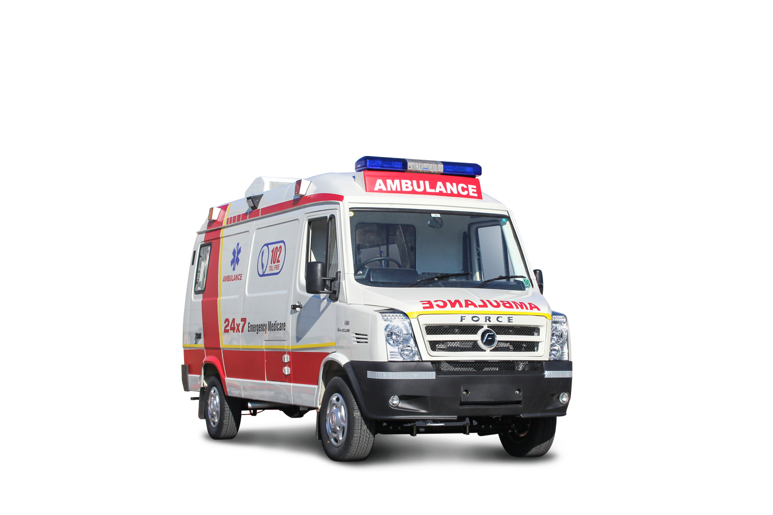
Analyzing Loss Systems
Resources: 3 trauma bays (m=3 )
Trauma center moves to diversion status once all servers are busy
= incoming patients are directed to other locations
Demand Process
One trauma case comes in every 3 hours
(a = 3 hours)
a is the interarrival time
(exponentially distributed)
Service Process
Patient stays in trauma bay for an average of 2 hours
(p = 2 hours)
p is the service time
(any distribution)
What is P_{m} = the probability that all m resources are utilized?

Slide 16
a = interarrival time
p = processing time
m = # servers
Define r = p/a
Erlang Loss Table
Probability {all m servers busy} =

Slide 17
Loss Systems Finding P_{m}(r)
m
a = 3 hours, p = 2 hours, m = 3
What is P(all 3 bays are busy)?
r = 2 hours/ 3 hours = 0.67
From table: P₃(0.67) = 2.55%
# Ambulances diverted each hour?
Arrivals = 1/3 per hour x 0.0255 = 0.0085
How many hours per day system turns away ambulances?
2.55% x 24 hours = 0.612 hour = 36.72 minutes
r = p / a
Given P_{m}(r) we can compute:
Time per day that system has to deny access
Flow units lost = 1/a * P_{m} (r)

Slide 18
Loss Systems Improvements
a = 3 hours, p = 2 hours, m = 3
r = 0.67, P₃(0.67) = 2.55%
One more trauma bay
m = 4 → P₄(0.67) = 0.42% (84% down)
30 min faster process
p = 1.5 hours, r = 1.5/3 = 0.5
→ P₃(0.5) = 1.27% (50% down)
Pool two identical hospitals
a = 1.5 hours, r = 2/1.5 = 1.33, m = 6
→ P₆(1.33) = 0.21% (92% down)
m
r = p / a

Slide 19
Waiting Time vs Losses
Waiting problems
Utilization has to be less than 100%
Impact of variability is on Flow Time
Loss problems
Demand can be bigger than capacity
Impact of variability is on Flow Rate
Pure waiting problem, all customers are perfectly patient.
All customers enter the process, some leave due to their impatience
Customers do not enter the process once buffer has reached a certain limit
Customers are lost once all servers are busy
Variability is always bad – you pay through lower flow rate and/or longer flow time
Buffer or suffer: if willing to tolerate waiting, don’t have to give up on flow rate

Slide 20
Managing Queue Summary
Variability is the norm, not the exception
understand where it comes from and eliminate what you can
accommodate the rest
Variability leads to waiting times although utilization < 100%
Although capacity is expensive, having some “safety capacity” is necessary
Use quantitative tools (e.g., waiting time formula, Erlang loss) to
get a qualitative feeling of the system
analyze specific recommendations / scenarios
Next time: Managing queues through pooling and psychology (Friday 4/15)

Slide 21
Preview Pooling Queues
Pooled system:
One queue, four servers
Across these three types of systems:
Variability is the same: CV_{a} = 1, CV_{p} = 1.25
Total demand is the same: 1/35 customers per second.
Processing time is the same: p = 120
Utilization is the same: p / a x m = 85.7%
The probability a server is busy is the same = 0.857
a = 35
m = 4
Partially pooled system:
Two queues, two servers with each queue
For each of the 2 queues:
a = 35 x 2 = 70
m = 2
Parallel queue system:
Four queues, one server with each queue
For each of the 4 queues:
a = 35 x 4 = 140
m = 1
Think about: Which one is more effective?

Slide 22
What’s Next
Today: Pick a name for your team!
Friday: HW4 due, review Queueing concepts
Next Week: Littlefield Simulation
Starts Monday 1 pm, ends Thursday 4pm
No classes on Mon/Wed, make-up on Friday
You have access to platform! Look at historical data!
HW5 is out! You already know how to do 7 questions!
Notes:
https://forio.com/simulate/harvard/queuing-trial/simulation/
https://hbsp.harvard.edu/freetrial/4386-HTM-ENG/

